Slide 1

K15T2 – TEAM 02
TEAM ASSIGNMENT 08
VAN LANG UNIVERSITY

Slide 2
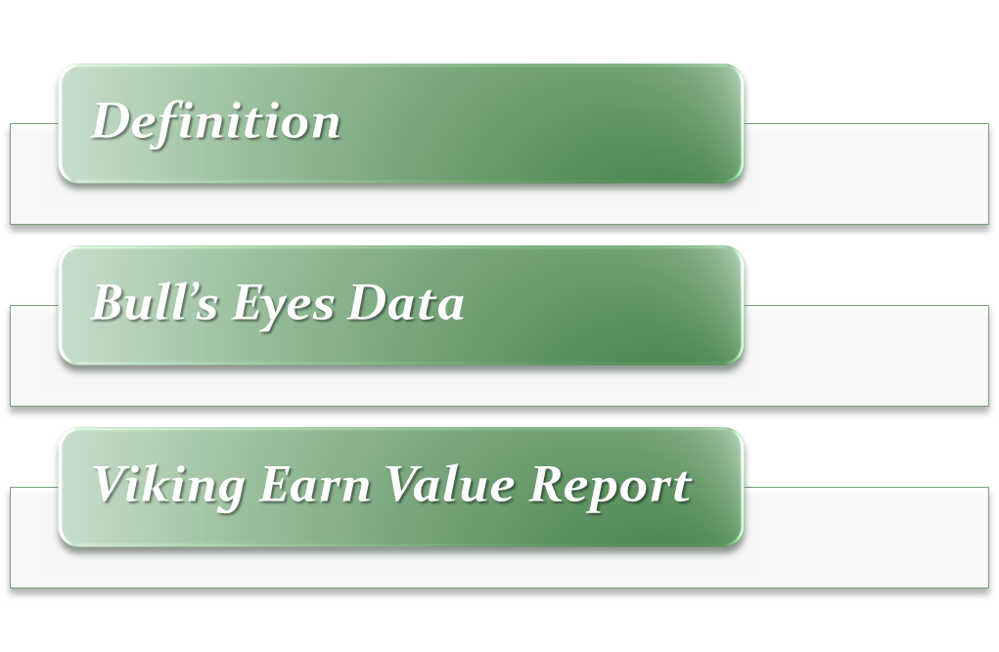

CONTENT

Slide 3
Definition
Earned Value is an objective measurement of how much “valuable work” has been completed on a traditional project.
Using EVM, PM can track project progress accurately and objectively by comparing how much work has actually been completed against the amount of work planned.
  Enables consistent tracking of project progress across portfolios of projects.
  Enables prediction of project completion.

Slide 4
CONTENT

Slide 5
Bull’s Eyes Data
 | BCWS | BCWP | ACWP
Project Data | $7,443.27 | $6,840.62 | $6,420.00
Setup and Project Management | $1,120.00 | $1,120.00 | $1,084.00
Release 1 - Deliver GUI & UserDocumentation | $1,332.00 | $1,332.00 | $1,292.00
Release 2 - Deliver Online Product | $2,434.86 | $2,434.86 | $2,164.00
Release 3 - Deliver Offline Product | $2,556.41 | $1,953.76 | $1,880.00
Release 4 - Deliver Final Product | $0.00 | $0.00 | $0.00

Slide 6

CONTENT

Slide 7
Viking Earn Value Report
According to file K15T2-Team22-Team Assignment8.xlsx
Viking project’s earned value data (assume at week 28):
BCWS | 7443.27
BSWP | 6840.62
ACWP | 6420.00
AC | 6420.00
CPI | 0.919034
SPI | 1.065517
BAC | 12148.20
VAC | -257.49
ISAC | 52.22873938
IEAC | 11401.22413

Slide 8
Viking Earn Value Report
Based on file Viking_EV_Data-up_to_w28.xlsx
IEAC = BAC/CPI = 11401.22413
Forecast the final costs will less than budget is: 12148.20 - 11401.22413 = $746.97587
ISAC = Project Duration/SPI = 52.22873938 weeks
  →The project will finish earlier than schedule 4 weeks.
  Conclude: according to data which collected at week 28, we can forecast the project costs and schedule at complete, the above results show that we not only decrease the final cost but also reduce the finish day. It is a positive sign.

Slide 9


THANKS FOR YOUR LISTENING

